Slide 1
Deep Learning Model for Big Data Classification in Apache Spark Environment
Team: 122ad0057 Shashi kumar
122ad0058 Gnaneswar
122ad0040 Sri Sai Nadh

Slide 2
Introduction
Big Data Classification: Used in industries like finance, healthcare, and cybersecurity.
Challenges:
Large feature sets affecting model performance.
Computational overhead in deep learning models.
Need for an better feature selection technique

Slide 3
Objectives
Develop an optimized deep learning model for big data classification.
Use SBOA (Sigmoid Butterfly Optimization Algorithm) for feature selection.
Implement OGRU (Optimized Gated Recurrent Unit) for better classification.
Deploy the model in a multi-node cluster using Hadoop and Spark.

Slide 4
Problem Statement
Handling high-dimensional datasets efficiently.
Selecting optimal features to improve model performance.
Reducing training time while maintaining high accuracy.

Slide 5
Technologies & Frameworks
Programming Language: Python
Libraries: TensorFlow, Keras, PySpark, Pandas, NumPy
Frameworks: Hadoop, Apache Spark (Multi-Node Cluster)
Feature Selection: SBOA
Deep Learning Model: OGRU

Slide 6
System Architecture
Data Ingestion: HDFS (Hadoop Distributed File System)
Feature Selection: SBOA
Model Training: OGRU using PySpark on Hadoop Cluster
Evaluation Metrics: Accuracy, F1-score, Precision, Recall
Deployment & Optimization: Multi-node Spark cluster

Slide 7
Data Preprocessing
Handling missing values.
Feature Scaling & Normalization.
Feature Selection using SBOA.

Slide 8
Feature Selection with SBOA
SBOA: Inspired by butterfly behaviors for optimal feature selection.
How it Works:
Reduces irrelevant and redundant features.
Balances exploration and exploitation for better feature subset selection.
Advantages:
Improves model accuracy.
Reduces training time.
Enhances classification performance.

Slide 9
OGRU Deep Learning Model
Gated Recurrent Unit (GRU): Optimized for sequential data processing.
Enhancements in OGRU:
Improved weight initialization.
Adaptive learning rate.
Optimized training efficiency.
Why OGRU?
Faster convergence than LSTM.
Suitable for large-scale classification.

Slide 10
Model Training & Experimentation
Dataset: epsilon_normalized.t
Training Details:
Training on multi-node Spark cluster.
Hyperparameter tuning.
SBOA Feature Selection:
For executing it takes 3 hrs.

Slide 11
RESULTS
Comparison metrics
Accuracy
Observations:
SBOA improves feature selection efficiency.
OGRU achieves better classification accurac

Slide 12
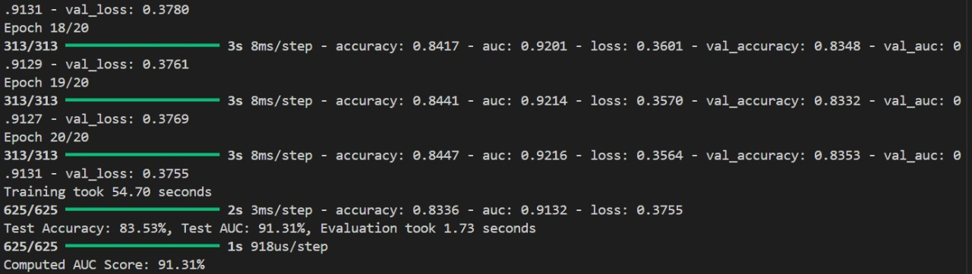
Results

Slide 13
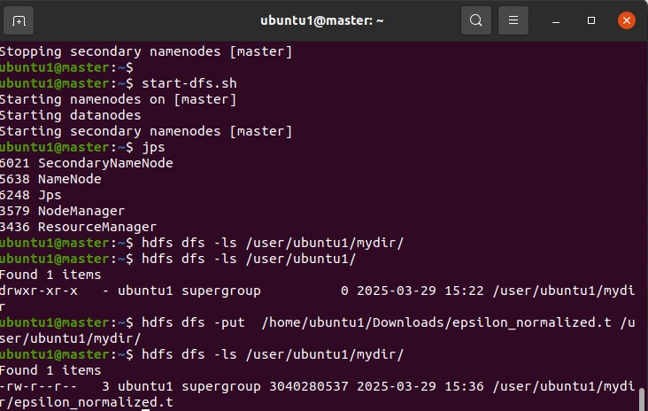
Executing in multi cluster:

Slide 14
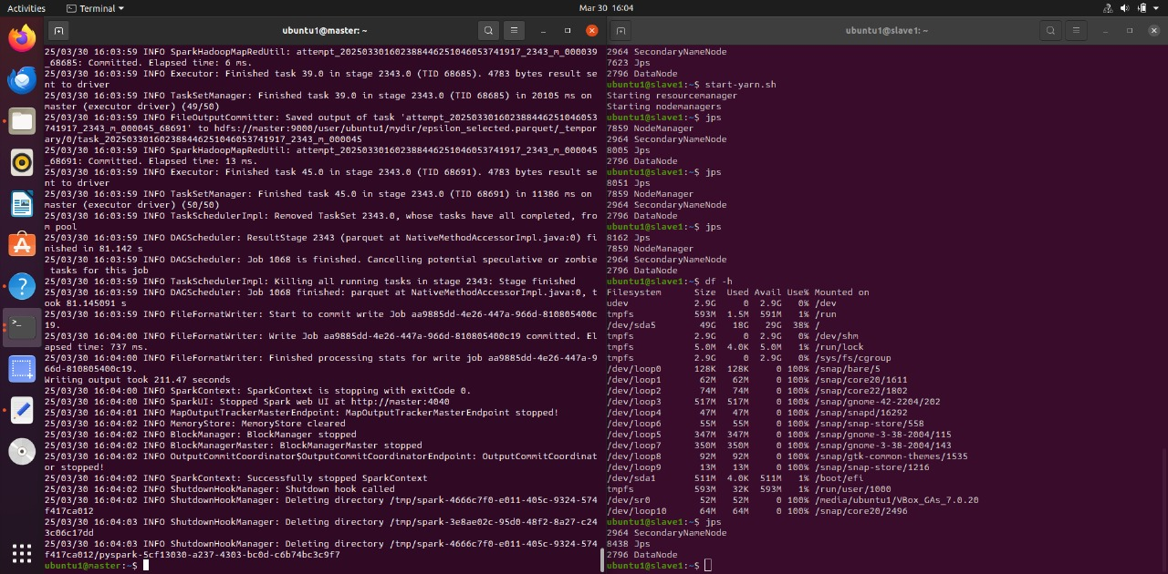

Slide 15
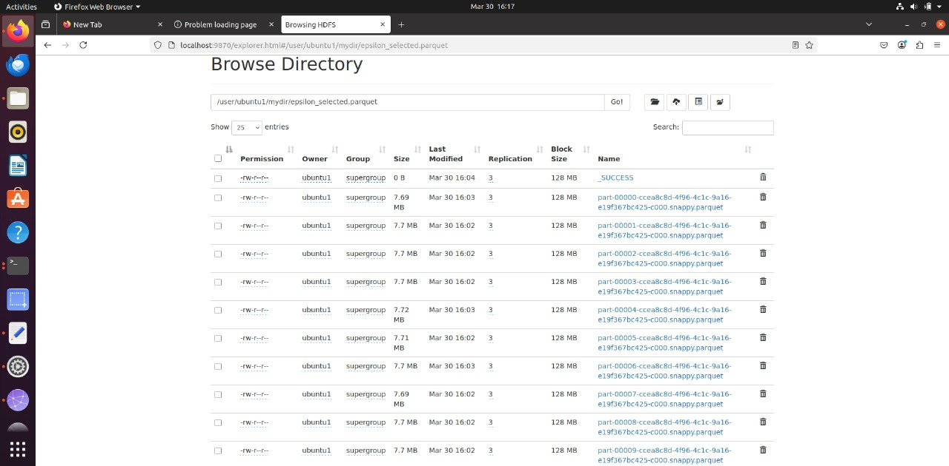

Slide 16
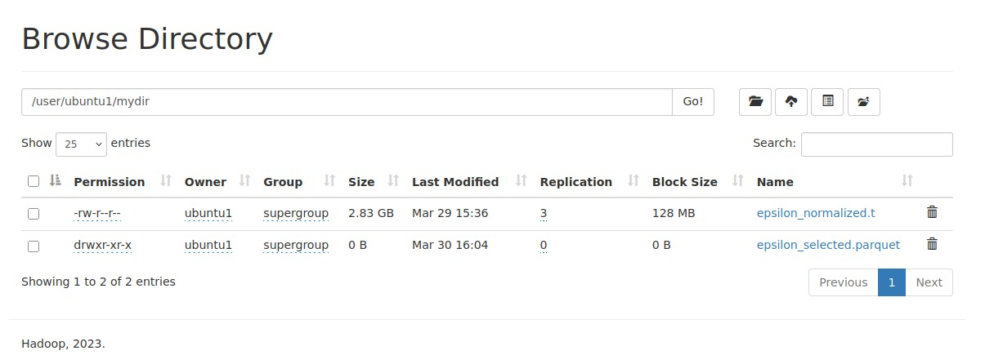

Slide 17
Limitations
Apache Kafka for Real-time Data Streaming
Why Kafka?
A distributed event streaming platform designed for high-throughput data ingestion.
Decouples data producers (e.g., IoT devices, web logs) from data consumers (Hadoop/Spark).
Handles fault tolerance and horizontal scaling efficiently.

Slide 18
How it works
How Kafka Helps in This Project
Enables real-time feature selection using SBOA.
Supports efficient batch and stream processing for OGRU model training.
Reduces data latency and enhances scalability in big data classification.

Slide 19
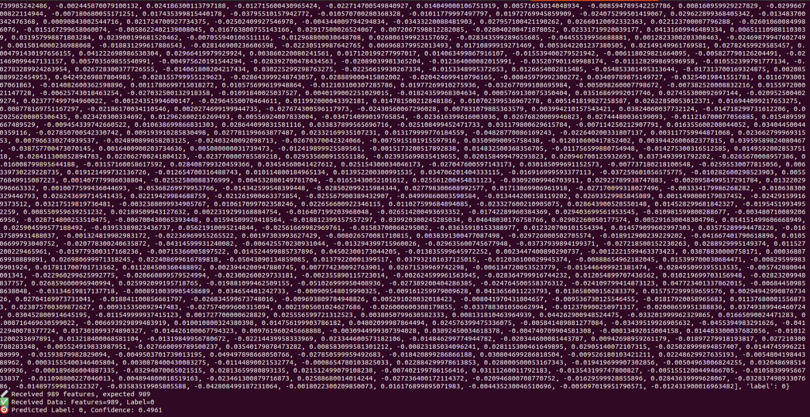
Results using Apache Kafka

Slide 20
Conclusion
Successfully implemented Deep Learning for Big Data Classification.
SBOA improved feature selection and model performance.
OGRU Model achieved better accuracy and efficiency.
Future Work: Optimizing further for real-time classification.

Slide 21
References
[1] M. A. Khan, M. Karim and Y. Kim, “Atwo-stage big data analytics framework with real world applications using spark machine learning and long Short-term memory network,” Symmetry, vol. 10, no. 10, pp. 485–496, 2018.
[2] L. R. Nair and S. D. Shetty, “Applying spark based machine learning model on streaming big data for health status prediction,” Computers & Electrical Engineering, vol. 65, no. 1, pp. 393–399, 2018.

Slide 22
References
[3] L. Hbibi and H. Barka, “Big data: Framework and issues,” in Proc. of Int. Conf. on Electrical and Information Technologies (ICEIT 2016), Tangier, Morocco, pp. 485–490, 2016.
[4] M. Assefi, E. Behravesh, G. Liu and A. P. Tafti, “Big data machine learning using apache spark MLlib,” in Proc. of the 2017 IEEE Int. Conf. on Big Data, Boston, MA, USA, pp. 3492–3498, 2017.
[5] A. Abbasi, S. Sarker and R. H. Chiang, “Big data research in information systems: Toward an inclusive research agenda,” Journal of the Association Information Systems, vol. 17, no. 2, pp. 1–33, 2016.

